Slide 1
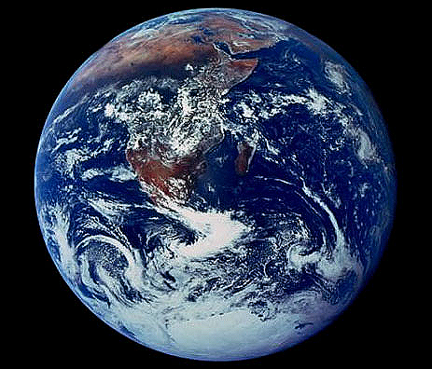
Causes of the
New Imperialism

Slide 2
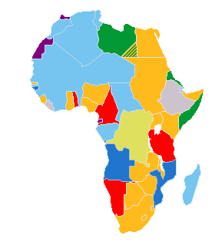
What We Will
Learn Today:
What was the old Imperialism?
Where did the new imperialism take place?
What factors led to the new Imperialism?
How did the Industrial Revolution lead to the new Imperialism?

Slide 3
The Old Imperialism
Imperialism – when one country controls the political, economic, or cultural life of another country.
Sphere of Influence – area in which an outside power claims exclusive trade privileges.

Slide 4
The Old Imperialism
Review
The Old Imperialism was led by Spain and Portugal during the 1500s. The imperialized territory was the New World of the Americas.
Spain and Portugal were motivated by the three “G’s”:
P
S
1. Gold
2. Glory
3. God

Slide 5
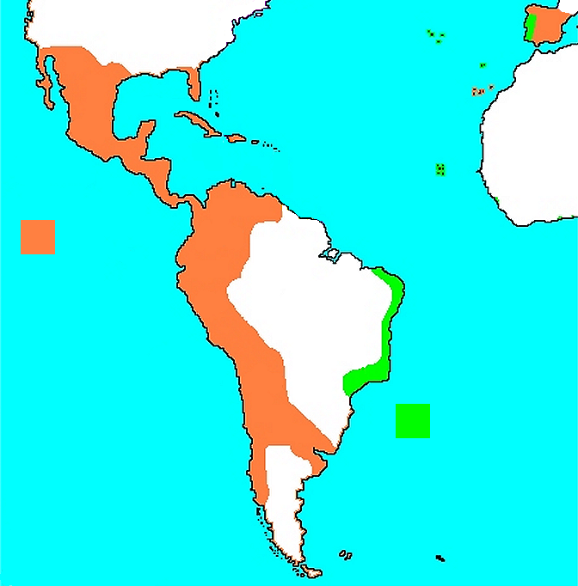
Old Imperialism: Spanish & Portuguese Empires, 1700
Spanish
Portuguese

Slide 6
The New Imperialism
New Conquests
The leaders of the new imperialism were Britain, France, Italy, Germany, and Belgium.
B
G
B
F
The setting for the new imperialism was Africa and Asia, from approximately 1870 to 1960.
I

Slide 7
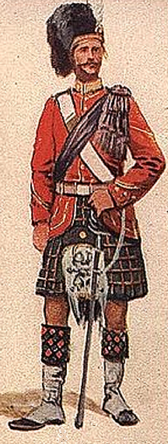
Causes of Imperialism
.
1. Militarism
Military power was commonly used to achieve a nation’s goals.
Resupply ports where needed along the west and east coasts of Africa.
A nation with more colonies had more power, security, trade, money, and colonial men for their army.

Slide 8
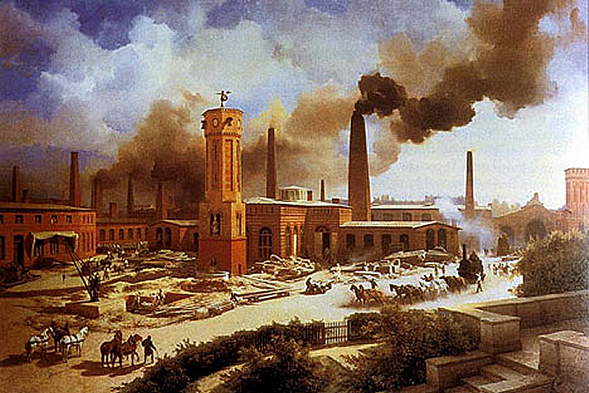
Causes of Imperialism
2. Industrialization
Industrialists needed more raw materials to supply factories and foreign markets where they could sell their finished products.
Industrialists also needed places to invest their profits, which would multiply their riches.

Slide 9
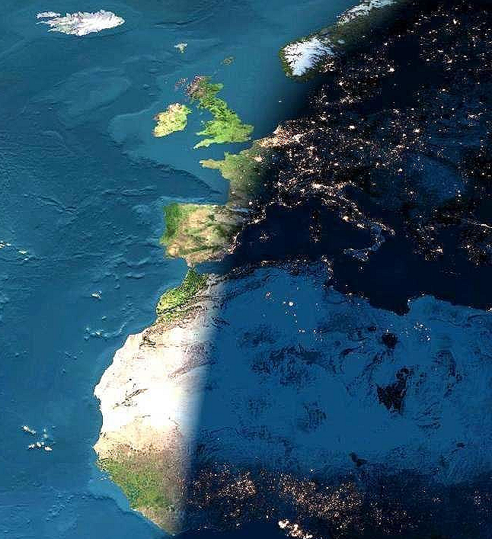
Causes of Imperialism
3. Nationalism
National pride led many nations to strive for a world empire.
Most Europeans felt their nationality was superior to that of the Africans and Asians.
British boasted, “The sun never sets on the British Empire.”
Germans wanted to have its “place in the sun.”

Slide 10
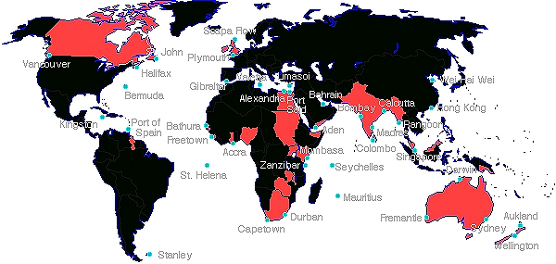
“The Sun never sets on the British Empire”

Slide 11
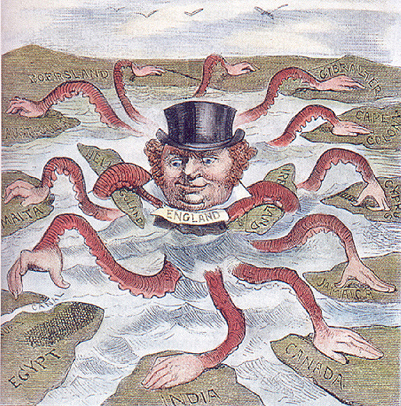

Slide 12
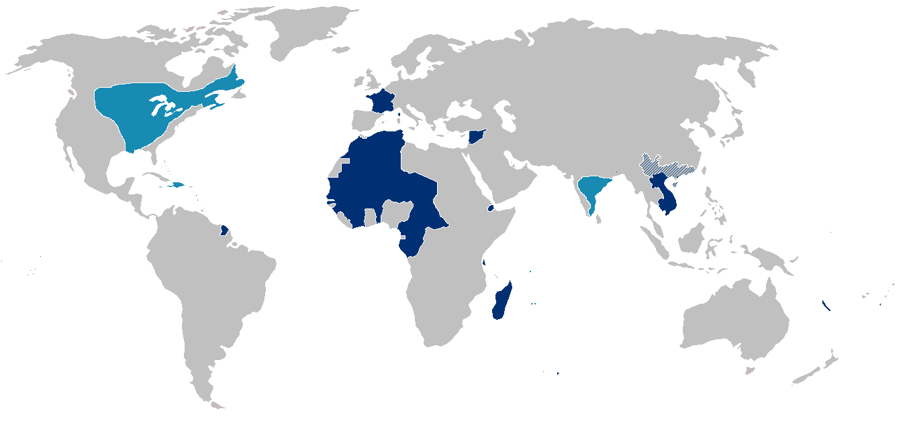
French Colonial Empire
First Colonial Empire
Light Blue: 1600-1800
Second Colonial Empire
Dark Blue: 1800-1950

Slide 13
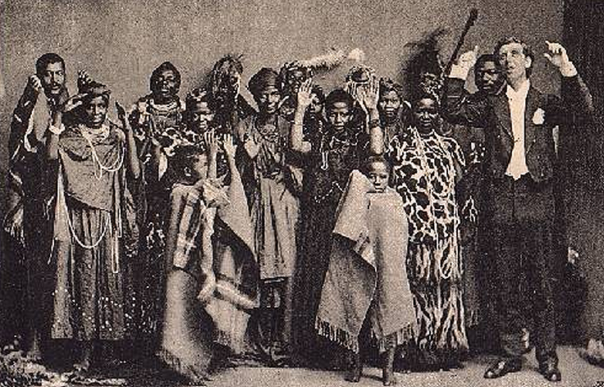
Causes of Imperialism
4. Religion
Christian missionaries wanted to help Africans and Asians, and worked to carry the “White Man’s Burden,” which included:
1. Christianizing the natives in order to civilize them.
2. Bringing natives the technological benefits of western civilization.
3. Teaching Africans to read and write.

Slide 14
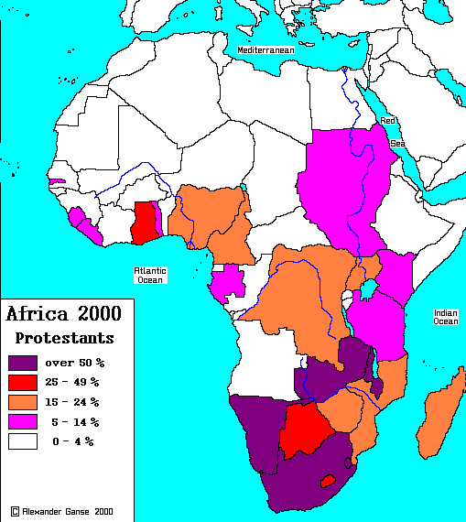

Slide 15
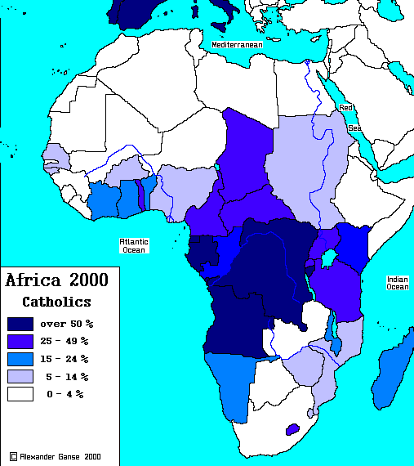

Slide 16
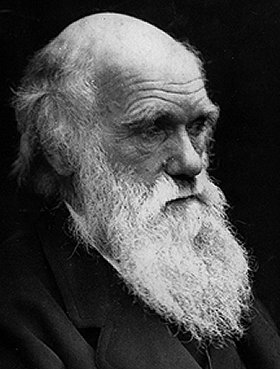
Causes of Imperialism
5. Social Darwinism
Darwin’s theories of natural selection and survival of the fittest were used by many to support imperialism.
Many Europeans believed that it was natural and right for strong nations to conquer weaker ones.
Defeating a weaker race, could only strengthen the human race.
Charles Darwin

Slide 17
Review of Key Concepts
What is imperialism?
Imperialism – when one country controls the political, economic, or cultural life of another country.
What were the five main causes of imperialism?
Social
Darwinism
Militarism
Industrialization
Nationalism
Religion

