Slide 1
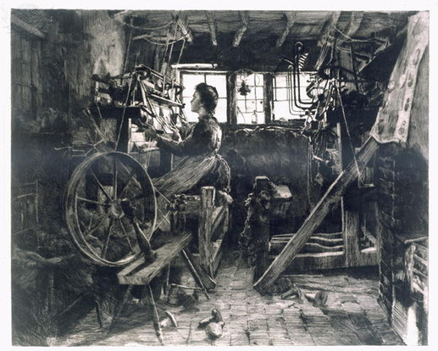
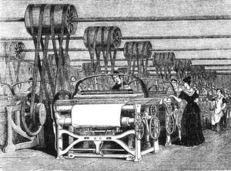
Compare and Contrast the Two Pictures
Look for differences and similarities

Slide 2
Preview
Watch the following video, jot down some main ideas or pictures that you notice.
Flocabulary

Slide 3
Vocabualry Preview
Write as many sentences as possible that show relationships between two of the vocabulary words.
Example: Assembly lines are used in many industries.

Slide 4
Main Idea + Vocabulary
MAIN IDEA: Beginning in the 18th century and continuing through the 19th century, machines began to replace workers in factories, which greatly increased the speed and amount of goods that were able to be produced.
VOCABULARY: Cottage Industry; Industry

Slide 5
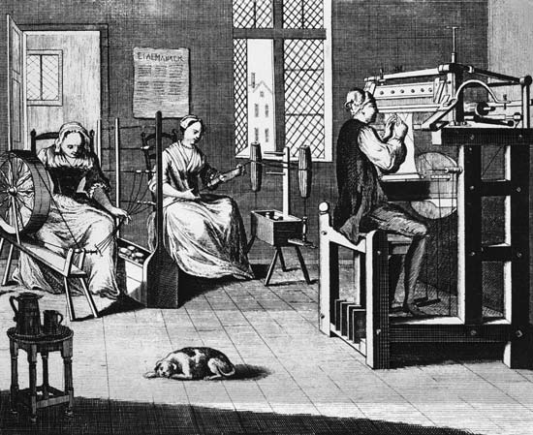
Life before
Before the Industrial Revolution, people made things by hand, often in their own homes, in a system called a “cottage industry” because people worked in their own homes – cottages.
An “industry” is a particular type of economic activity (for example, the soda industry, the shoe industry, or the clothing industry).

Slide 6
Causes
The Industrial Revolution began in England and spread from there.
England’s geographic placement is important because it was safe from many of the damaging wars that destroyed parts of Europe in the 19th century.
Today, we are going to explore the causes of the Industrial Revolution in England and throughout Europe in general.
You will have 15 minutes to read about each of the six different categories of causes and take down the information onto your guided notes.

Slide 7
Causes
New inventions
Natural Resources
Geographic Modifications
Lots of Wealth
Constitutional monarchy
Market Economy

