Slide 1
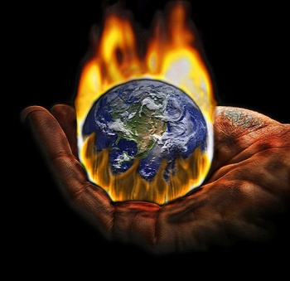
World At War Rise of Dictators

Slide 2
The Rise of Dictators Causes
The Treaty of Versailles wasn’t fair
The world-wide Great Depression made matters far worse
Desperate people = more willing to believe that a single person can solve problems
After WWI, totalitarian dictators began to emerge in Europe and Asia

Slide 3
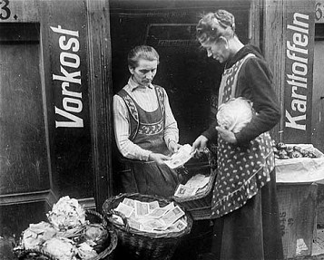
Trouble in Europe
The Great Depression is worldwide - but especially hard in Germany
(due to the
Treaty of Versailles -$33 billion penalty)

Slide 4
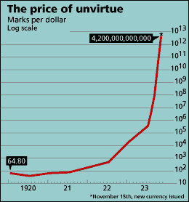
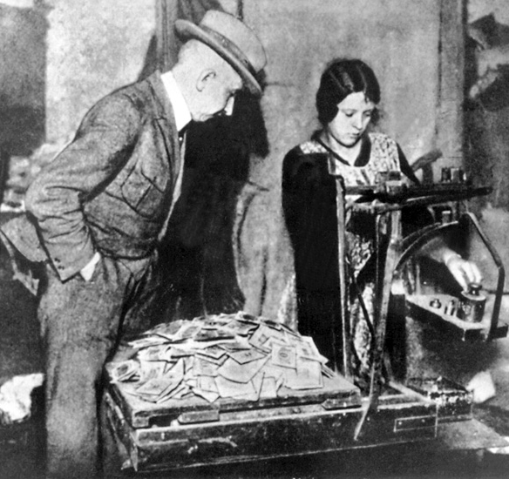
Trouble in Europe - Inflation
Inflation - a rise in prices relative to money available.
In other words, you can get less for your money than you used to be able to get.

Slide 5
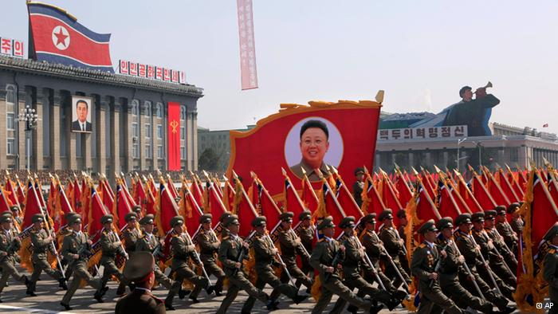
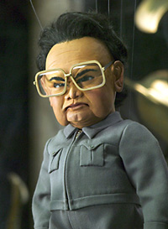
Dictator
Dictator - person who rules a country with total authority and often in a cruel or brutal way.

Slide 6
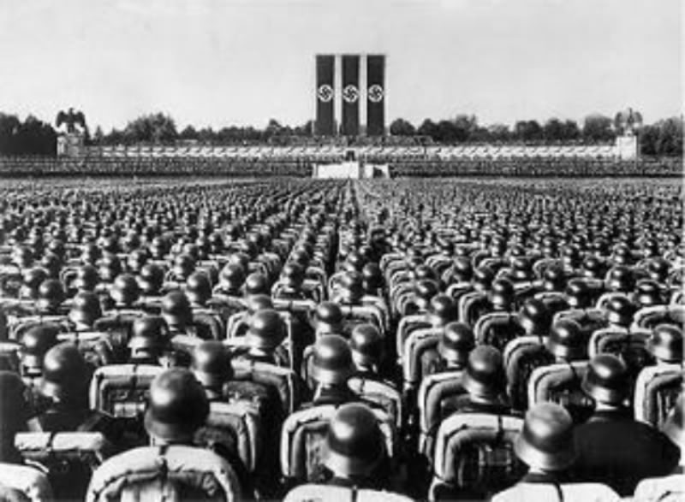
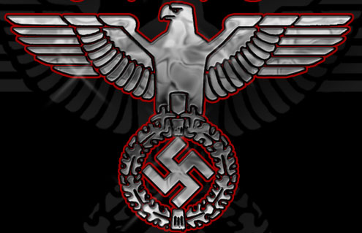
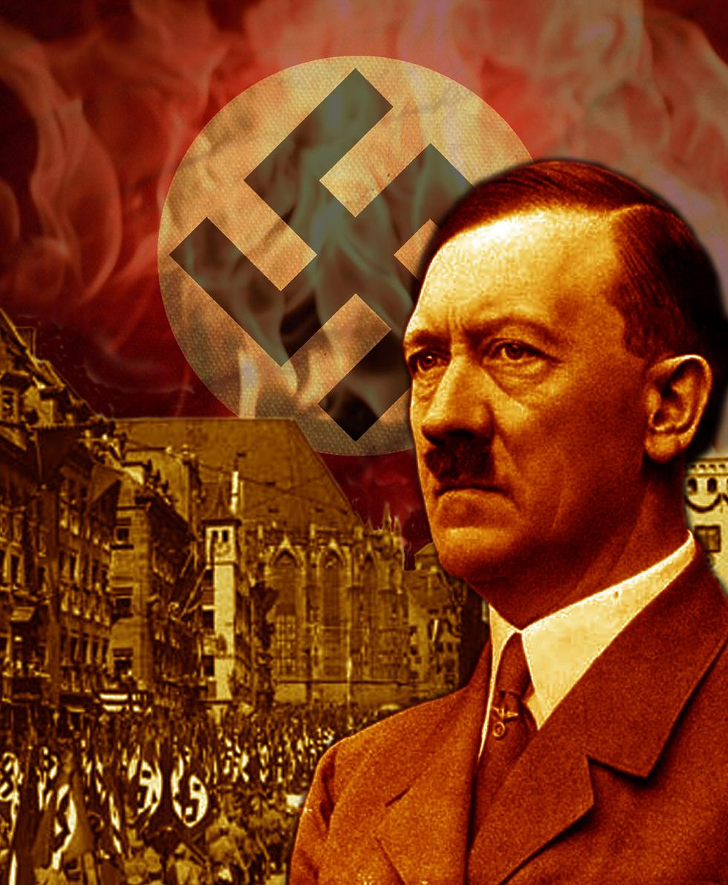
Nazis
Nazi - a member of a German political party that controlled Germany from 1933 to 1945 under Adolf Hitler

Slide 7
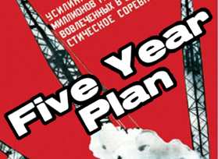
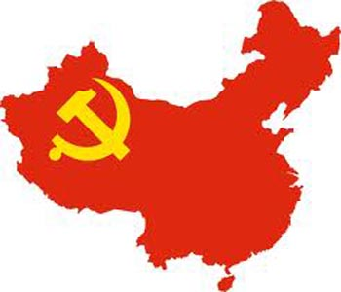
Five Year Plan
Five Year Plan - any plan for national economic or industrial development specifying goals to be reached within a period of five years, (practiced in the Soviet Union and China.

Slide 8
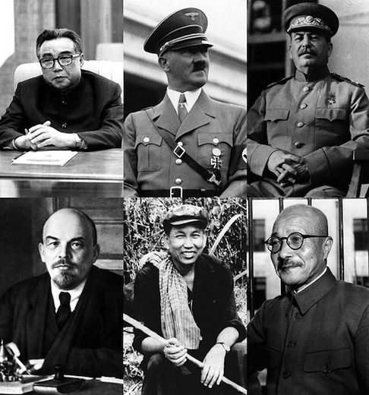
Totalitarian Government
Totalitarianism – a political party or group controlling the people of a country in a very strict way with complete power that cannot be opposed

Slide 9
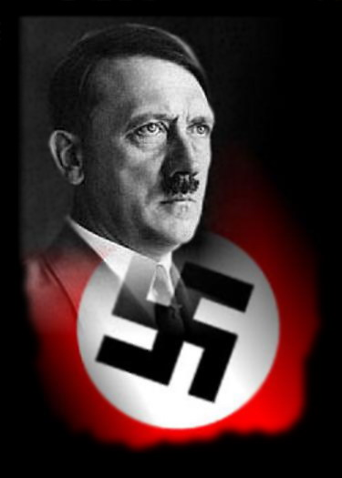
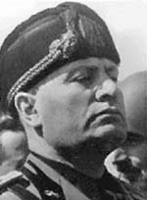
Fascism
Fascism - a way of organizing a society ruled by a dictator, the people are not allowed to disagree with the government
Fascism believes the country is more important than the person.

Slide 10
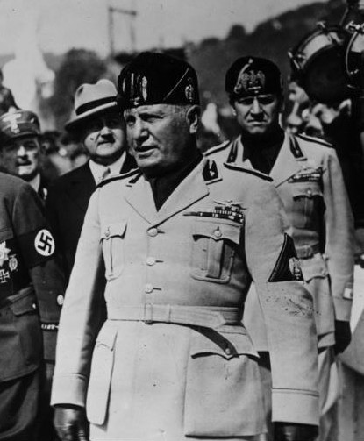
Mussolini in Italy
1919: Benito Mussolini started the Fascist Party in Italy.
Mussolini pledged to take Italy back to the glory days of the Roman Empire.

Slide 11
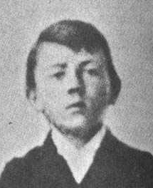
ADOLF HITLER
Born poor in Austria
Very good in school, religious
and considered becoming a monk
Dropped out of high school
WWI - happy…but refused
to fight for Austria
Moved to Germany and
volunteered to fight

Slide 12
Hitler in Germany
Adolf Hitler admired Mussolini
Hitler began to associate with the National Socialists German Workers Party. Better known as the Nazi Party.
Nazi Party symbol - a swastika.
Arrested in 1923 for trying to start a revolution called the Beer Hall Putsch.

Slide 13
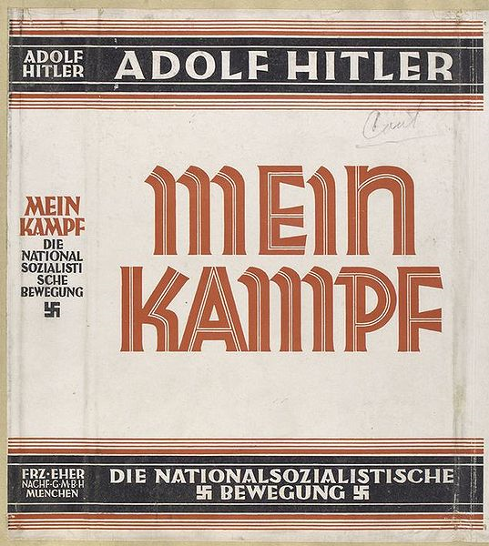
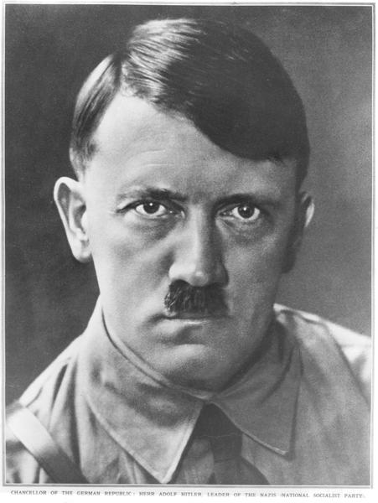
Hitler in Germany
While in jail, wrote his autobiography titled Mein Kampf (My Struggle).
After prison, he became Chancellor of Germany in 1933 and President in 1934.

Slide 14
Hitler in Germany
Hitler was the leader of Germany from 1933 to 1945.
Leader of the Nazi party - a powerful dictator

Slide 15
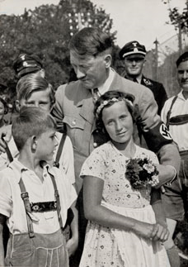
The “Master” Race
In Mein Kampf, Hitler describes what he considers to be the master race, was called Aryans.
Blonde hair and blue eyes were considered superior over everyone else.
Believed Aryans needed more living space.
one of his many reasons for invading Europe.

Slide 16
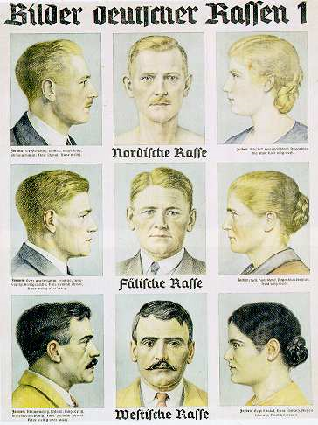
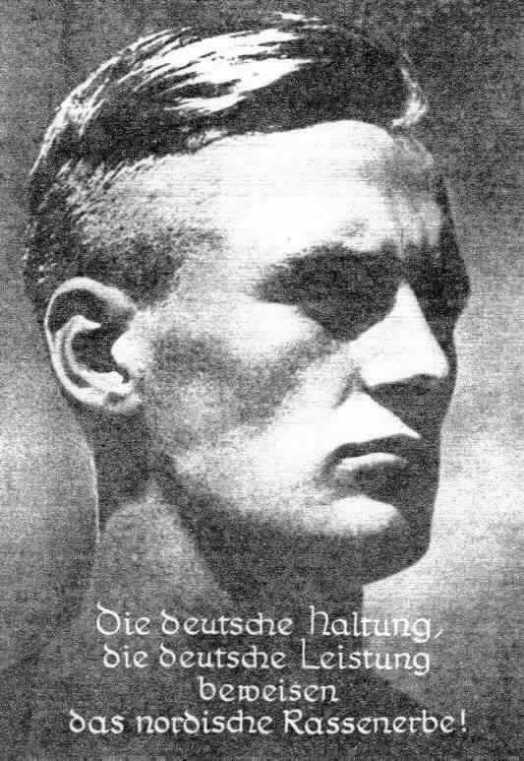

Slide 17
Stalin in Russia (USSR)
By 1917, after the Russian Revolution, the country was called the Union of Soviet Socialists Republics (USSR).
Joseph Stalin: leader

Slide 18
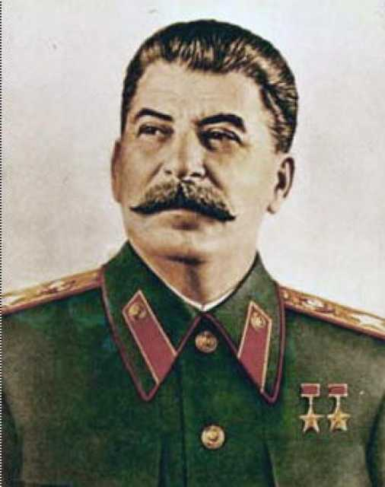
Stalin in Russia (USSR)
Pushed communism ruthlessly and forcefully killing 8-10 million Russians.
Responsible for more deaths than any other in human history.

Slide 19
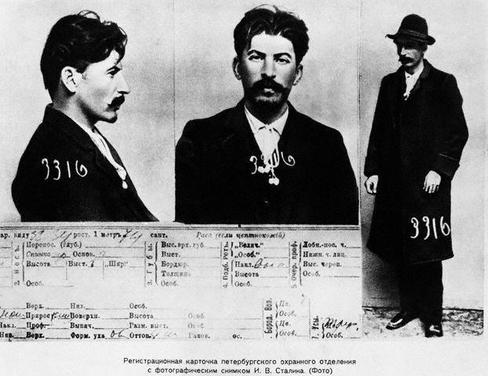
Stalin’s mug shot after being arrested as a Communist in his early years

Slide 20
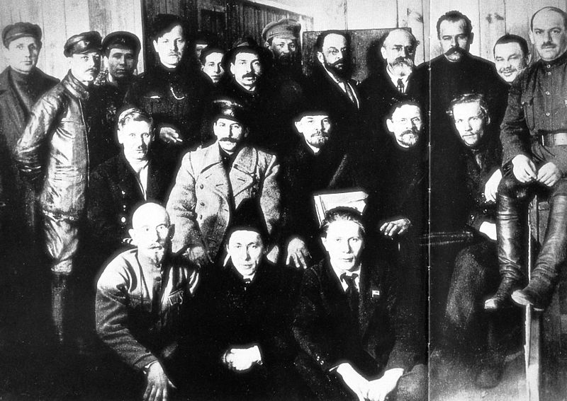
STALIN LENIN

Slide 21
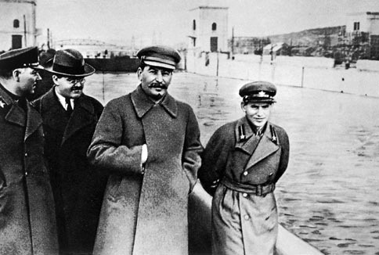
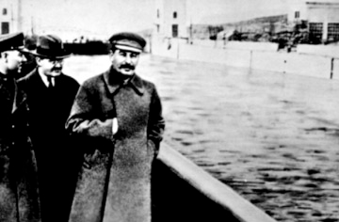
Stalin was the most ruthless of all the dictators towards his own people. If he didn’t trust you…he killed you…and then photo shopped you.

Slide 22
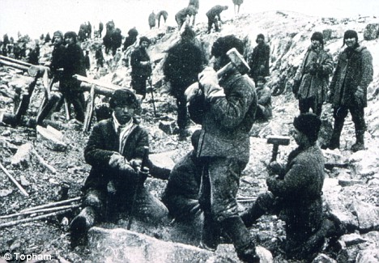
Stalin’s Siberian Labor Camps

Slide 23
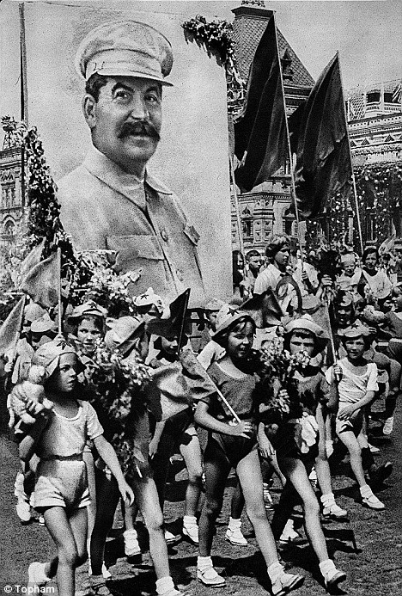
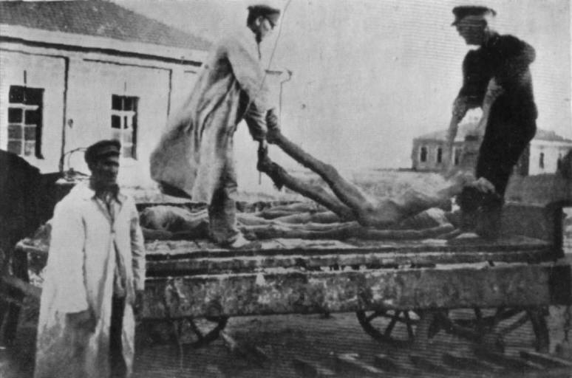

Slide 24
Meet Japanese Emperor Hirohito
Born in Tokyo, 1901, the eldest son of Crown Prince Yoshihito.
Emperor of Japan (1926 -1989)
His role in Japan’s government in WWII is highly important.

Slide 25
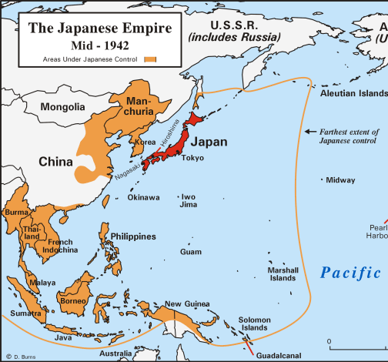
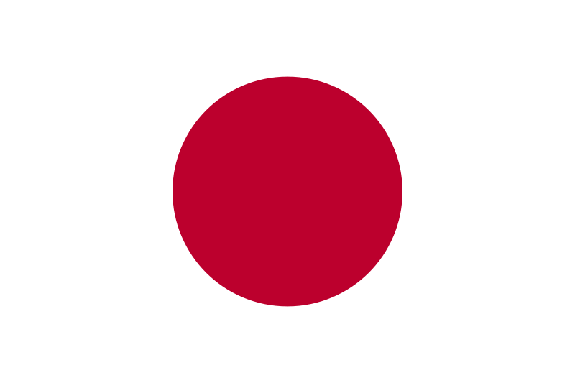
Militarists Control Japan
Being an island, Japan lacks many resources
In the Depression other countries crushed Japan because they rely on many imports.

Slide 26
Japan Occupies Manchuria
The military took over the government
Believed the only way Japan could prosper is if they controlled more of Asia
1931 – Japan invaded Manchuria, China for its resources

Slide 27
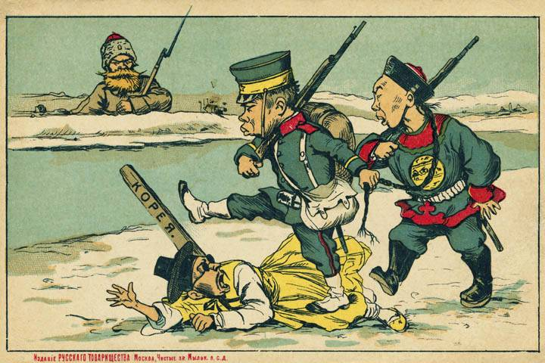
Japan Annexes Korea

Slide 28
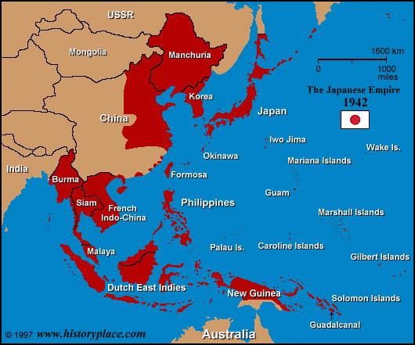
Review:
1) Manchuria Incident (1931): Ultranationalist take over democracy, military fakes attack on Jap. railroad in Chinese Manchuria, Jap invades.
2) Japan Invades Rest of China (1937): KMT forced to join with CCP to fight Japan.

Slide 29
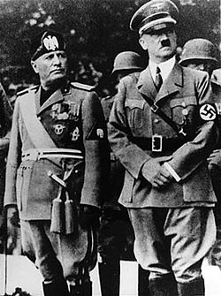
Very Soon Hitler, Mussolini, and the Japanese all entered into relationships. Eurasia was becoming very dangerous.

Slide 30
