Slide 1
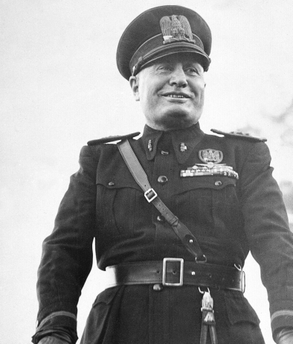
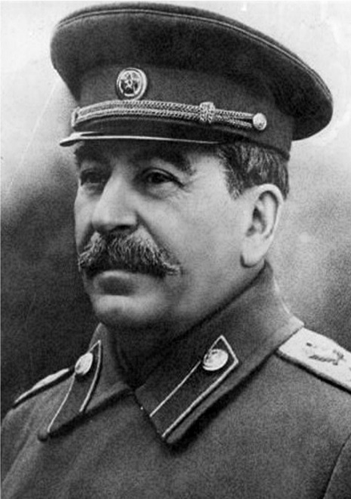
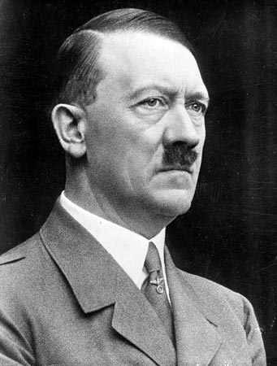
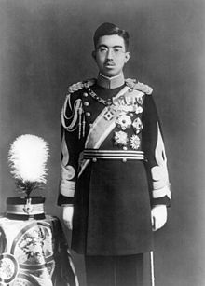
The Rise of Dictators & World War II
Vocabulary

Slide 2
Rise of Dictators
dictator- a person who rules a country with total authority and often in a cruel or brutal way
totalitarian- a governing system in which a ruling elite holds all power and controls all aspects of society, allowing no opposition and often maintaining power with the use of terror and secret police
fascism- a dictatorship that is nationalist (pride in one’s country) and racist
inflation- a rise in prices relative to money available. (You get less for your money than you used to be able to get.)

Slide 3
censor- to examine something in order to remove parts of it that are considered objectionable
coup- a sudden, violent overthrow of an existing government by a small group
Five Year Plan- a plan for national economic or industrial development specifying goals to be reached within a period of five years, especially as undertaken by the Soviet Union or China
Benito Mussolini- An Italian dictator who founded the concept of a fascist government where there is one leader and one party that has total power. He was an inspiration to Adolf Hitler.

Slide 4
Adolf Hitler- the leader of Germany from 1933 to 1945. He was the leader of the Nazi party and became a powerful dictator. Hitler started World War II by invading Poland and then invading many other European countries. He is also known for wanting to exterminate the Jewish people in the Holocaust.
Nazi- a member of a German political party that controlled Germany from 1933 to 1945 under Adolf Hitler
Josef Stalin- leader of the Soviet Union known for his brutal leadership. He was responsible for the deaths of over 20 million people. Stalin ruled up until his own death in 1953.

Slide 5
Emperor Hirohito- emperor of Japan from 1926 to 1989. He remained emperor after the war. The first time his subjects heard his voice was when he announced Japan’s surrender on the radio.

