Slide 1
Types of Government
Who holds the power?

Slide 2
Autocracy
The power of one!

Slide 3
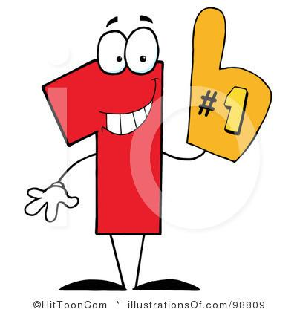
Autocracy
Political power held by one person
auto= self
cracy=power
Two types of autocratic governments
dictatorship
monarchy

Slide 4
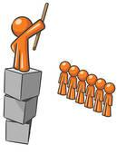
Dictatorship
A dictatorship is a form of government where one leader has absolute control over citizens’ lives.
Ex.: Kim Jong Un of North Korea

Slide 5
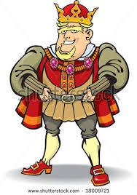
Monarchy
mono= one
A monarchy is ruled by a king or queen.
Rule is often hereditary where power is passed down.
Ex: England and Saudi Arabia

Slide 6
Democracy
Power to the People!!

Slide 7
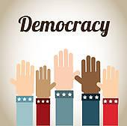
Democracies
Political power held by people of the country.
Demos= people
cracy= power
Two types of democracies
direct democracy
representative democracy
Ex: United States, Iran, Turkey

Slide 8
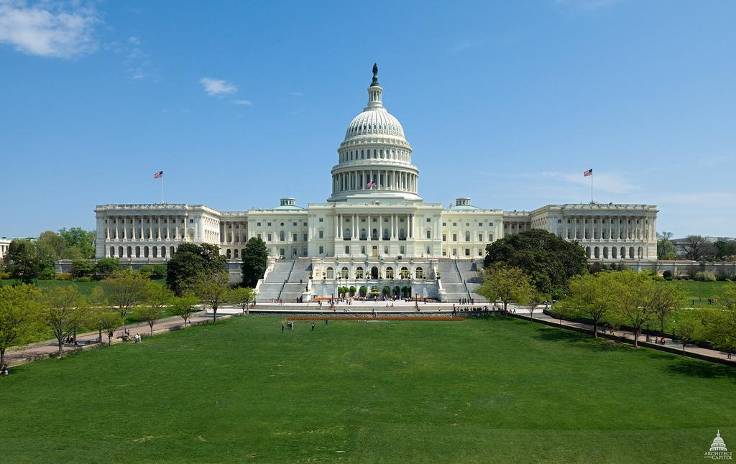
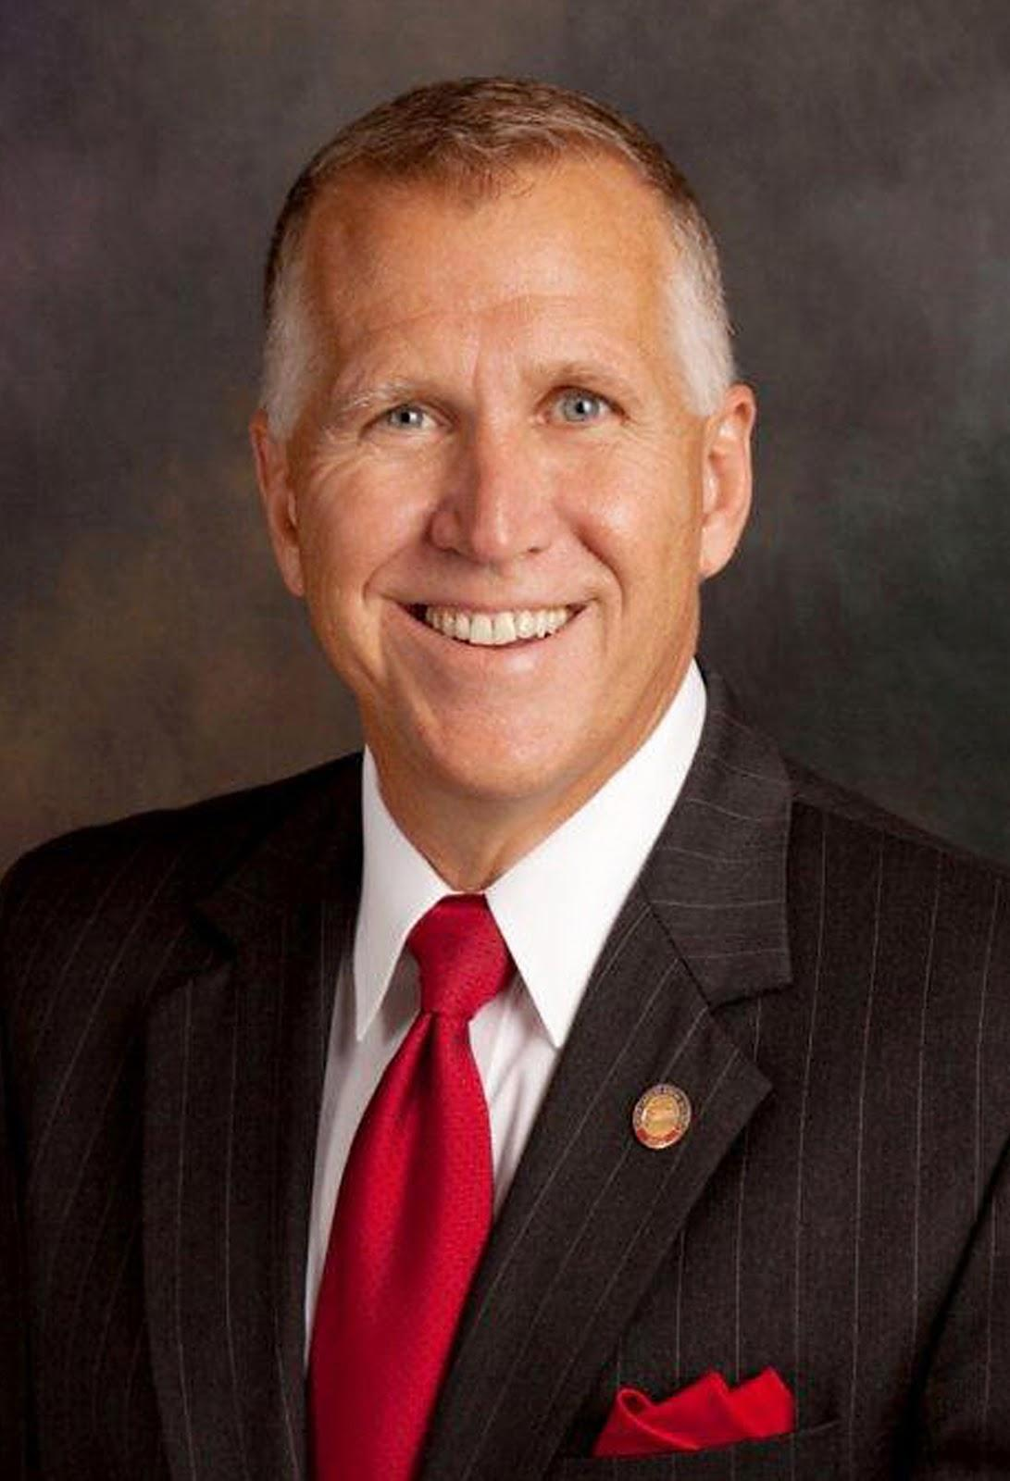
Representative Democracy
The citizens elect leaders to represent their rights and interests.
Citizens hold all the power.

Slide 9
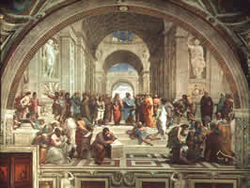
Direct democracy
No representatives
Citizens are responsible for the day to day running of the government
Example: Ancient Greece

Slide 10
Others
Wait!! There’s more…

Slide 11
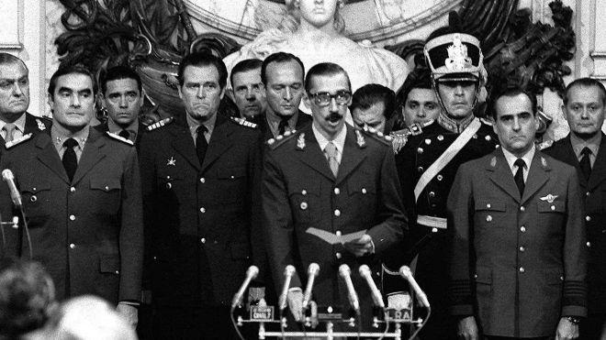
Oligarchies
Power is held by a small group of people.
oligos= few
Examples: one political party, one family, or one ethnic group.
Sometimes, this means the military holds the power.

Slide 12
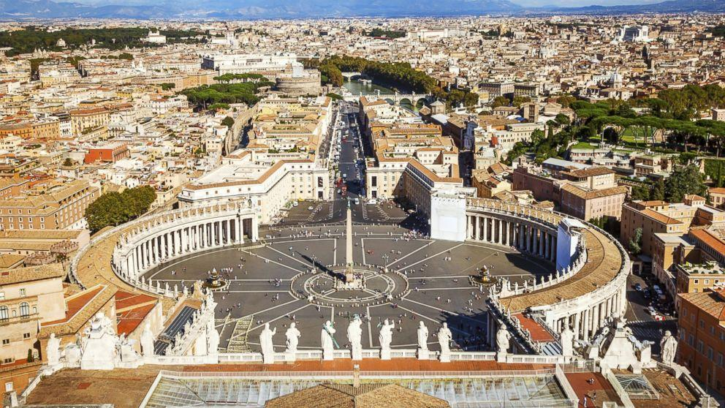
Theocracy
God is recognized as the ultimate authority.
theo= god
cracy=power
Religious law decides disputes.
often in combination with another type of government. .

Slide 13
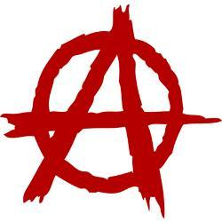
Anarchy
There is no person in control of the government.
It is used to describe groups of people BEFORE they form governments.
No anarchies exist today.

Slide 14
